Slide 1



MITRON BANK
Credit Card Strategy
SUBHOJEET SARKAR

Slide 2

Executive Summary
In this analysis, we explored 4,000 urban customers to understand credit card spend behavior and proposed a 3-card portfolio to address target segment needs effectively.

Slide 3
Business Need
Identifying Key Segments and Features
Identifying customer segments and tailored card features is crucial for enhancing adoption, maximizing spend, and ensuring timely repayments.

Slide 4

Process
DATA CLEANING
MODELING
KPI CALCULATION
Ensuring accuracy through thorough data review processes.
Applying statistical methods to identify patterns and trends.
Defining key metrics to track performance effectively.

Slide 5
~1,240M
Total Income Generated
43%
Utilization Rate Achieved
~531M
Total Spend Recorded

Slide 6
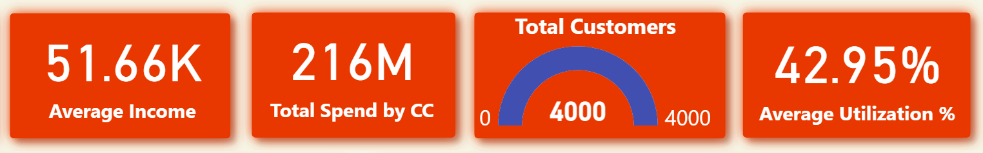

Slide 7
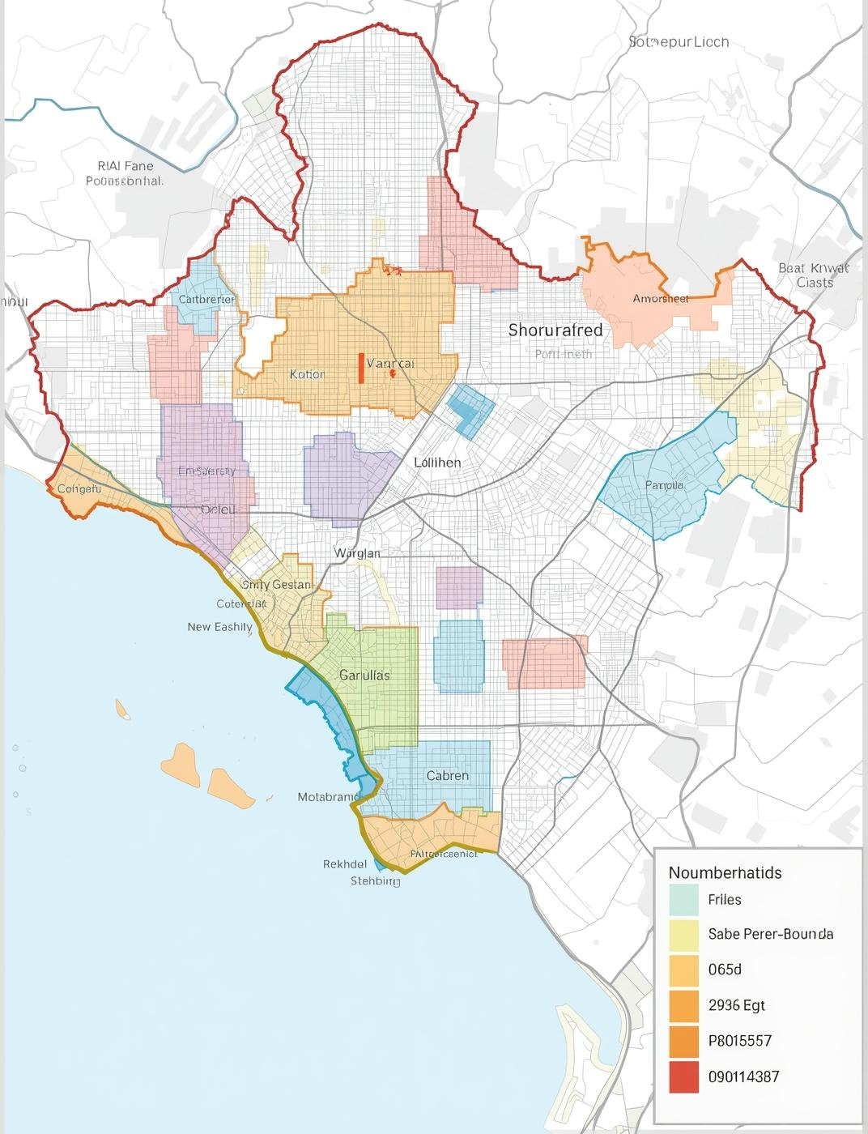
Segment Performance
Key Demographics Overview
This analysis focuses on five major metropolitan areas with a special emphasis on Mumbai, highlighting the core segment of married salaried IT professionals aged 25–34.

Slide 8
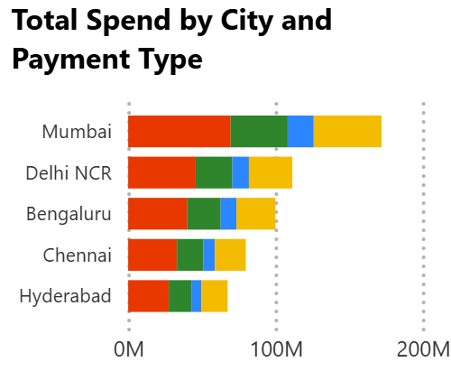
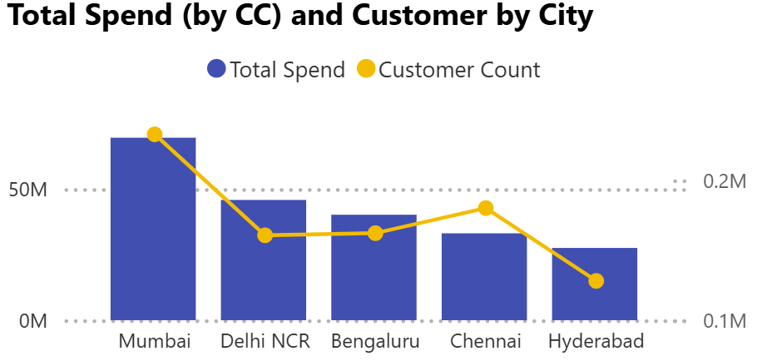

Slide 9
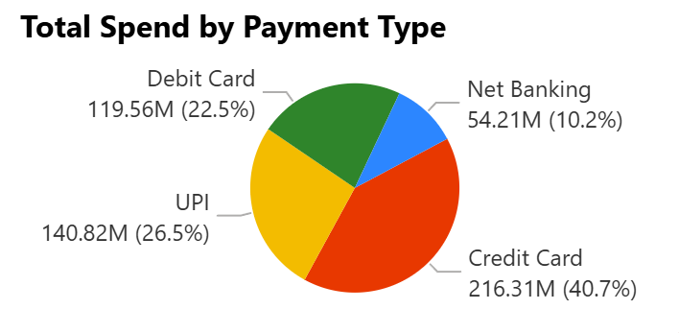
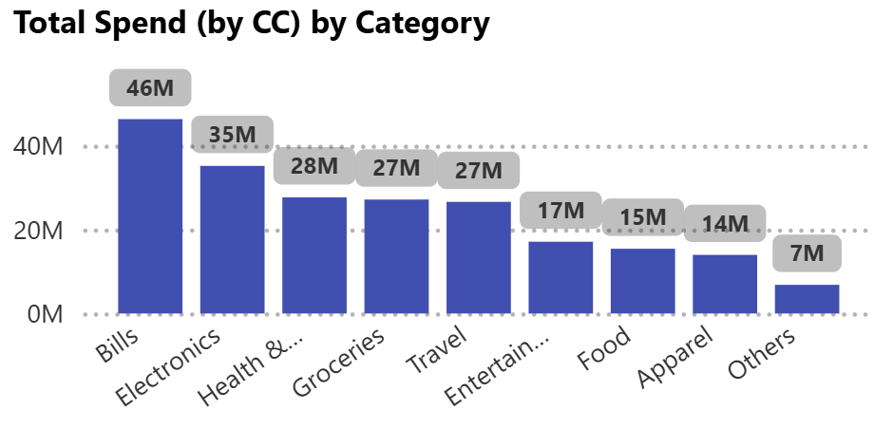
Spend Category Insights
Dominance of Payment Trends
Analyzing customer spending reveals key insights into daily habits. Major categories include bills, groceries, electronics, health, and travel. Notably, UPI and debit transactions dominate these expenditures, highlighting a significant opportunity for expanding credit card usage among consumers in these areas.

Slide 10
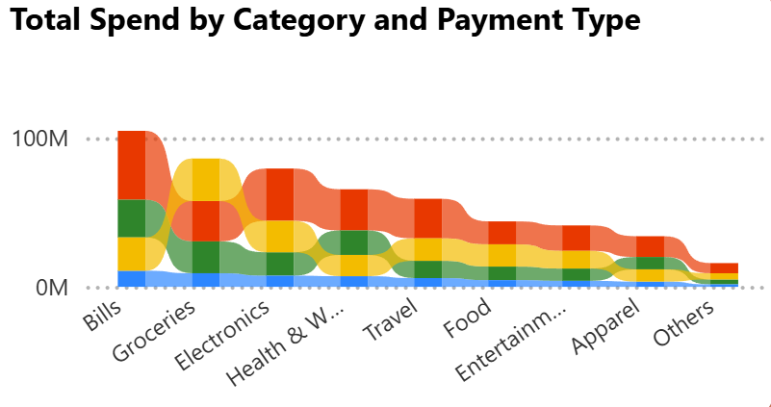

Slide 11

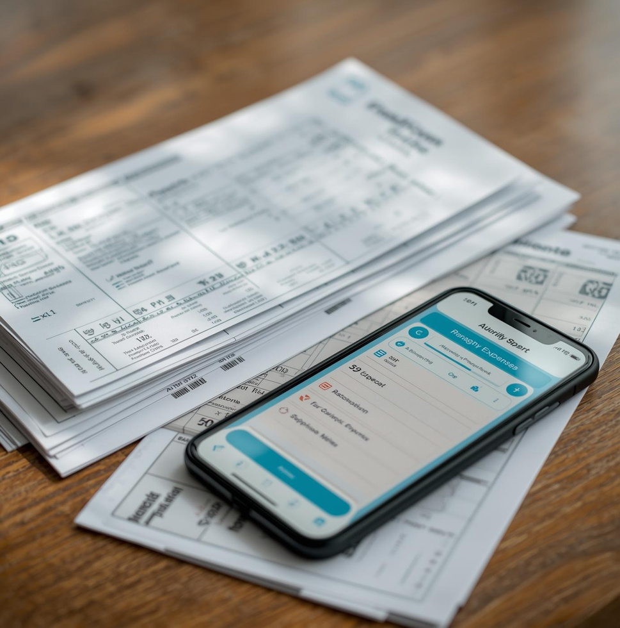

Spending Behavior
BILLS
GROCERIES
ELECTRONICS
Essential monthly expenses
Daily household needs
Tech purchases surge

Slide 12
Ideal Credit Card Segments
Primary Segment
Growth Segment
Targeting salaried individuals aged 25-45 who seek value and convenience in their credit card offerings.
Catering to small business owners, this segment requires flexible spending options and unique business-related benefits for growth.
Secondary Segment
Premium Segment
Focusing on early professionals aged 21-27, this group values rewards and benefits tailored to their lifestyle.
Targeting high net worth individuals, offering exclusive perks and tailored services to meet their unique financial needs.

Slide 13
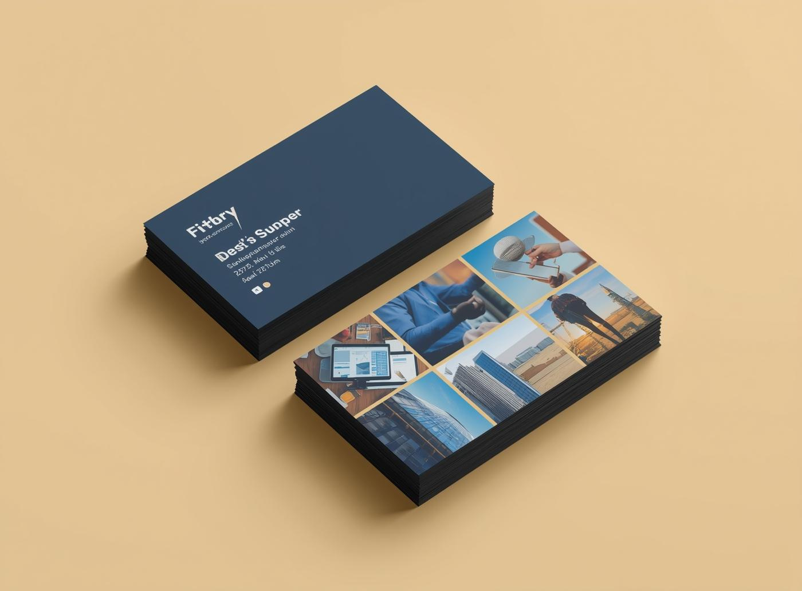
Proposed Credit Card Portfolio
Everyday Rewards Card
Designed for daily expenses, this card offers cashback on bills and groceries, rewarding customers for their regular spending habits.
Tailored product offerings for high-value customers
Lifestyle & Travel Card
This card enhances the travel experience with exclusive perks for airports, hotels, and entertainment, making it ideal for frequent travelers.
Business Edge Card
Targeting small business owners, this card provides benefits on office supplies and digital services, ensuring support for growing enterprises.

Slide 14

Features and User Experience
  01
  02
  03
  04
  05
Real-time alerts notify users of important transactions immediately.
Category caps help users effectively manage their spending habits.
Flexible EMIs offer personalized payment plans based on user needs.
Smart spend insights provide tailored recommendations for maximizing benefits.
Enhanced usability ensures a seamless experience for all customers.

Slide 15

Go-to-Market Strategy
Launch Phase 1
Launch Phase 2
Launch Phase 3
Launch Phase 4
Initiate marketing and promotional activities in Mumbai to build awareness.
Expand reach with campaigns in Chennai, targeting local consumer demographics.
Strengthen presence in NCR with focused digital engagement strategies.
Final rollout in Bengaluru, leveraging workplace tie-ups for customer acquisition.

Slide 16
Dashboard Visuals
The Next few pages features dynamic Power BI dashboards that illustrate key financial metrics and customer analytics, highlighting insights for informed decision-making in Mitron Bank's credit card strategy.

Slide 17
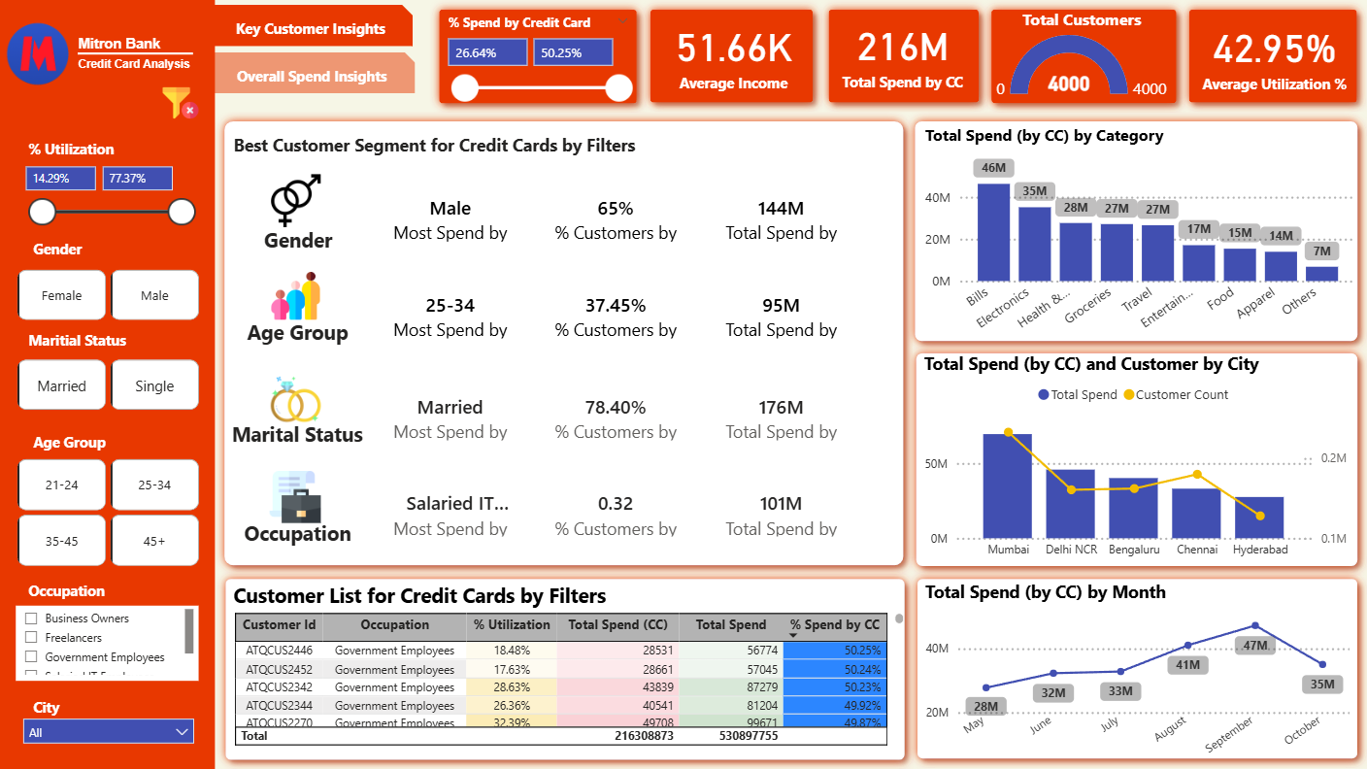

Slide 18
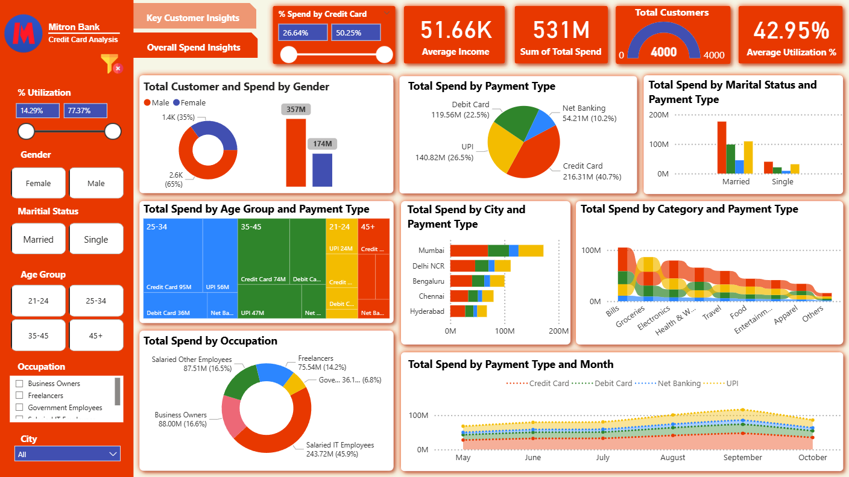

Slide 19
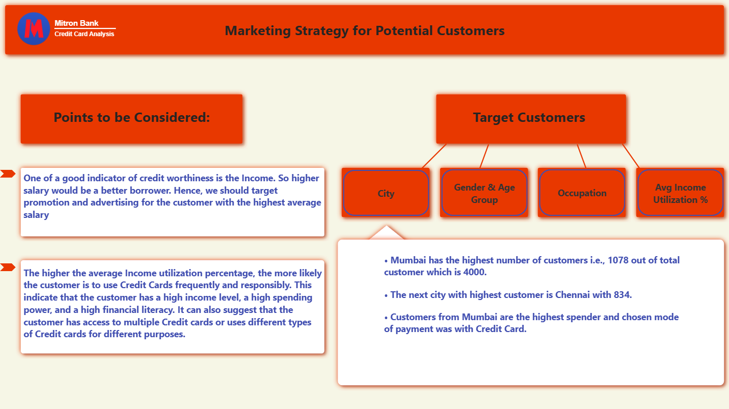

Slide 20
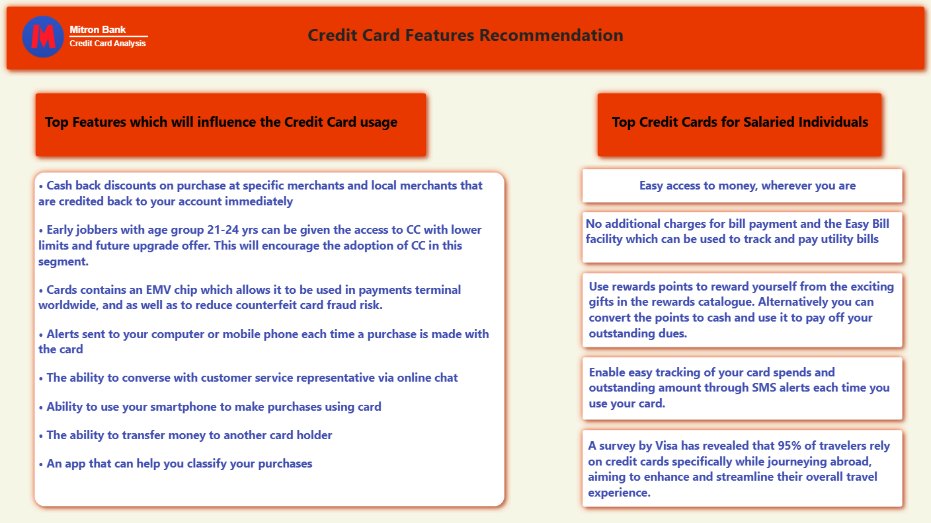

Slide 21
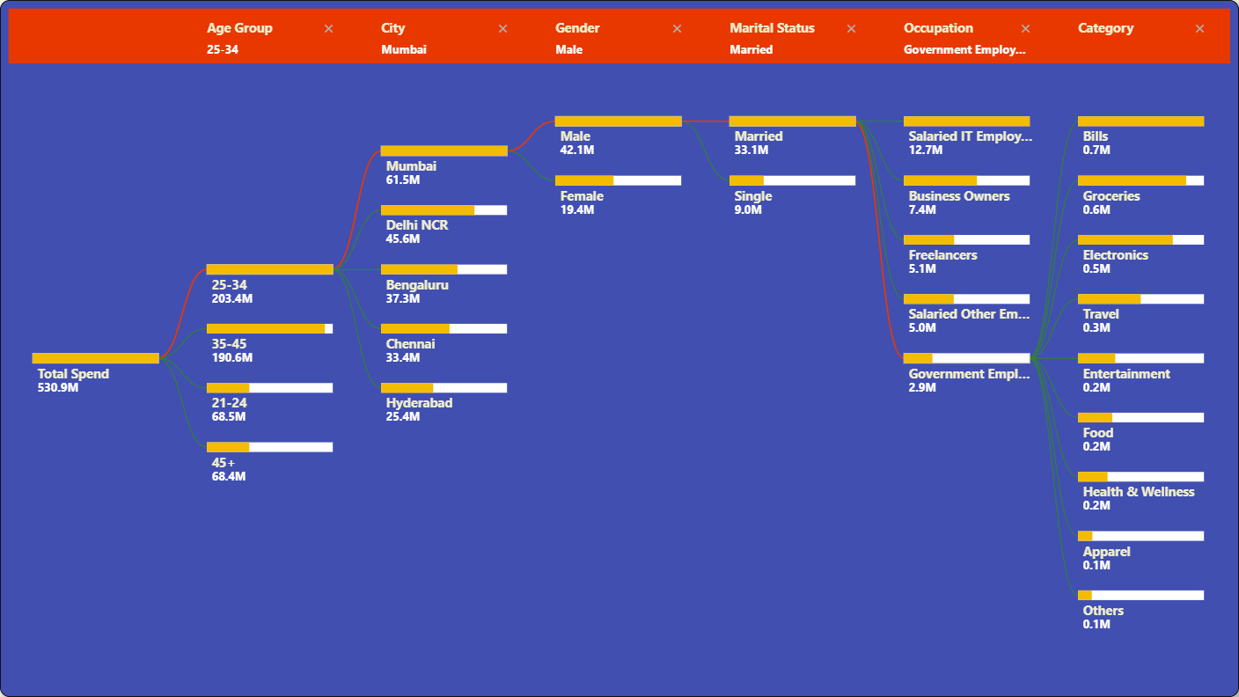

Slide 22
Thank You

